Slide 1
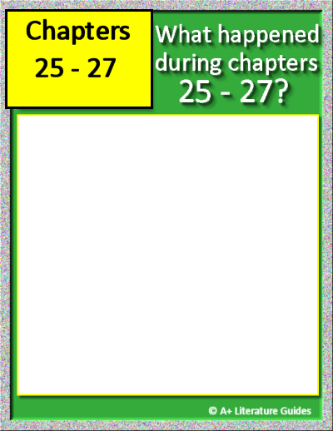
Chapter 25
Insert text
Insert text
Insert text
Insert text
Insert text
Chapter 26
Insert text
Insert text
Insert text
Insert text
Insert text
Chapter 27
Insert text
Insert text
Insert text
Insert text
Insert text
For each chapter, record:
Chapter’s setting
Main events
One of the following:
Character actions, relationships, traits
Internal/external conflicts/challenges, solutions/resolutions
Themes, messages
Questions, predictions
Mood, tone

Slide 2
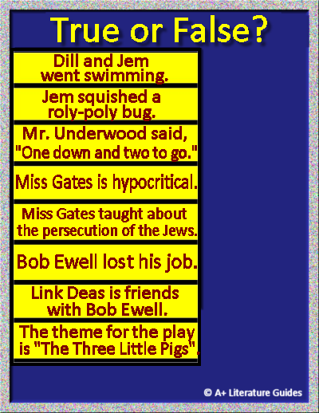



Drag and drop each option to correctly identify which statements are true or false.

Slide 3
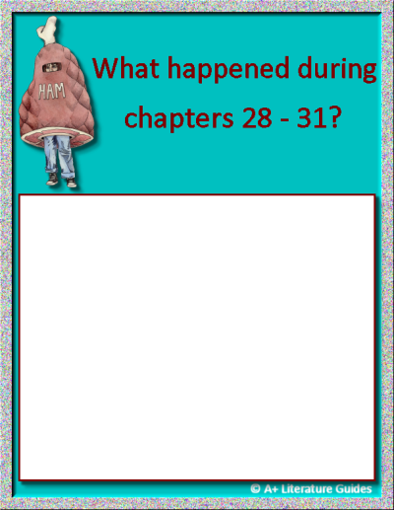
Chapter 28
Insert text
Insert text
Insert text
Insert text
Insert text
Chapter 29
Insert text
Insert text
Insert text
Insert text
Insert text
Chapter 30
Insert text
Insert text
Insert text
Insert text
Insert text
Chapter 31
Insert text
Insert text
Insert text
Insert text
Insert text
For each chapter, record:
Chapter’s setting
Main events
One of the following:
Character actions, relationships, traits
Internal/external conflicts/challenges, solutions/resolutions
Themes, messages
Questions, predictions
Mood, tone

